Slide 1
Exercise: Extracting Information from the Database
Please follow the instructions in the correct order.
Enter the commands correctly otherwise they will not work.
15 minutes

Slide 2
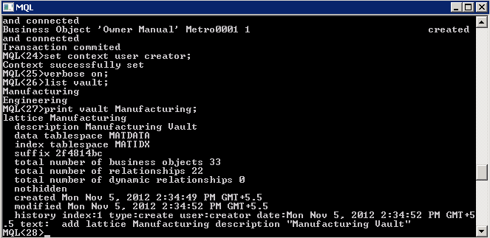
Do It Yourself (1/5)
Start the MQL Client: Click the corresponding icon or select the menu Start → Programs → Dassault Systemes EnoviaV6Server V6R2013x → MQL
Set context to user creator: set context user creator;
Turn system information on: verbose on;
Identify all vaults in the database: list vault;
Get all information in the data base on the Manufacturing Vault: print vault Manufacturing;
2
5

Slide 3
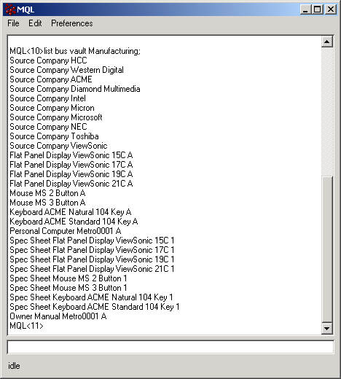

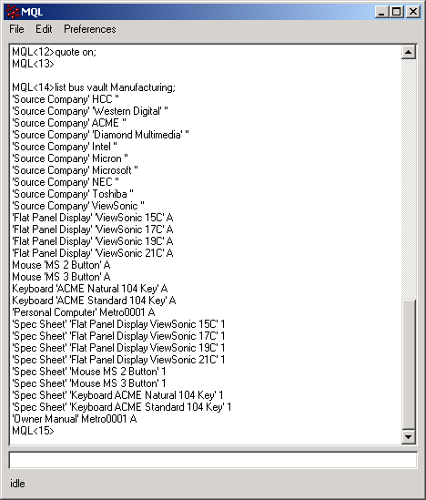
Do It Yourself (2/5)
Identify all Business Objects in the Manufacturing Vault: list bus vault Manufacturing;
By turning on the QUOTE function, we can differentiate between these very easily. Turn QUOTE on and look at all the objects in the Manufacturing vault again. quote on; list bus vault Manufacturing;
6
These results are hard to read because there is no separation between the TYPE, NAME and REVISION. It is very difficult to recognize which Business Object has a single or multi-word TYPE, NAME and/or REVISION.
7

Slide 4
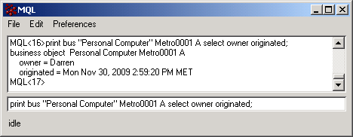
Do It Yourself (3/5)
Retrieving Business Object information
Query the database for information about the “Personal Computer” Metro0001 A. print bus “Personal Computer” Metro0001 A;
Use a select statement to display only who the owner is of the “Personal Computer” Metro0001 A. print bus “Personal Computer” Metro0001 A select owner;
Now display the owner and the date the object was created. print bus “Personal Computer” Metro0001 A select owner originated;
10

Slide 5
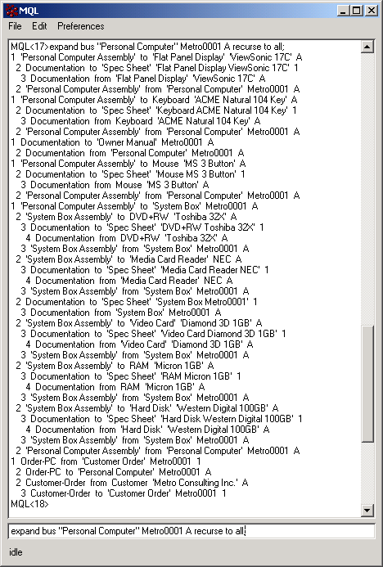
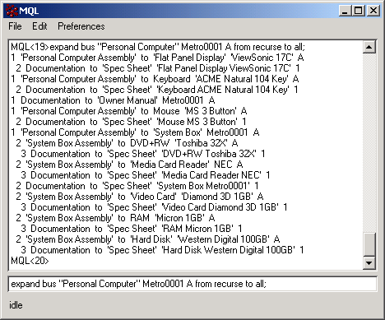
Do It Yourself (4/5)
Retrieving Business Object relationship information
Query the database for all objects connected to “Personal Computer” Metro0001 A. expand bus “Personal Computer” Metro0001 A recurse to all;
Show only objects connected where the Personal Computer is on the From side of connections. (BOM) expand bus “Personal Computer” Metro0001 A from recurse to all;
Show only objects connected where the System Box Metro0001 A is on the To side of connections. (Where Used) expand bus “System Box” Metro0001 B to recurse to all;
11
12

Slide 6
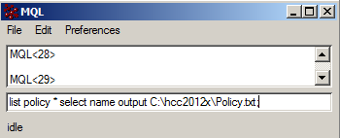

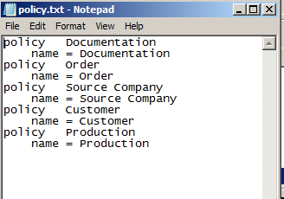
Do It Yourself (5/5)
Write output information into a file
14. Have your output result written to a file:
list policy * select name output c:\hcc2013x\Policy.txt;
15. Check the file.
1.b
Please note: in order to be able to output the list ADMIN_TYPE command result in a file you will need to state a select statement.

Slide 7
Exercise: Using Business Administration Commands
In this exercise you will use the Business Administration commands. Follow the instructions in the correct order. Type the commands correctly, otherwise they will not work.
10 minutes

Slide 8
Do It Yourself (1/2)
Start the MQL Client.
Set context to user creator: set context user creator;
Activate the system information display: verbose on;

Slide 9

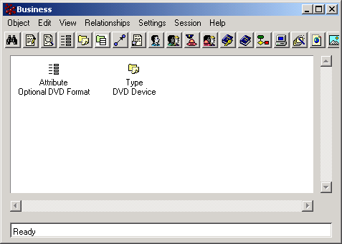
Do It Yourself (2/2)
Adding an Attribute and a Type to your data model using the MQL client.
Type the following commands to create the corresponding Administrative Objects:
add attribute “Optional DVD Format” type string default “Select an optional Format” range = none range = MP3 range = JPEG;
add type “DVD Device” abstract false derived “SYSTEM BOX PART” description “DVD Device for Personal Computer System Box” attribute “Optional DVD Format”;
Check your data model for the above objects.
4a
4b
5

